Slide 1
TwitterTruth – A DistilBERT-Powered Defense Against Misinformation
Team Details
Bharath Kandimalla (20EG105457)
Project Supervisor
B. Ravinder Reddy Assistant Professor,
Department of CSE

Slide 2
Introduction
Natural Language Processing (NLP) is a field of artificial intelligence (AI) that focuses on the interaction between computers and human language. Its primary goal is to enable machines to understand, interpret, and generate human-like text in a way that is both meaningful and contextually relevant.
What it is: This research explores the application of ALBERT and DistilBERT, two efficient BERT variants, for rumor detection on Twitter. Unlike CE-BERT, these models bring different strengths: ALBERT offers parameter-reduction techniques for better scalability, and DistilBERT provides a distilled version of BERT that is faster and smaller while retaining most of its capabilities.
What is needed: To implement this, one would need access to Twitter data, particularly datasets containing verified rumors and non-rumors. Additionally, computational resources to train and test these models are essential. Understanding of NLP and experience with transformer models like BERT, ALBERT, and DistilBERT is also required.

Slide 3
Introduction
Applications: The primary application of this research would be in social media monitoring, particularly for the automatic detection and flagging of potential rumors on Twitter. This could aid in controlling the spread of misinformation, helping fact-checkers, and providing researchers with insights into rumor dynamics on social media platforms

Slide 4
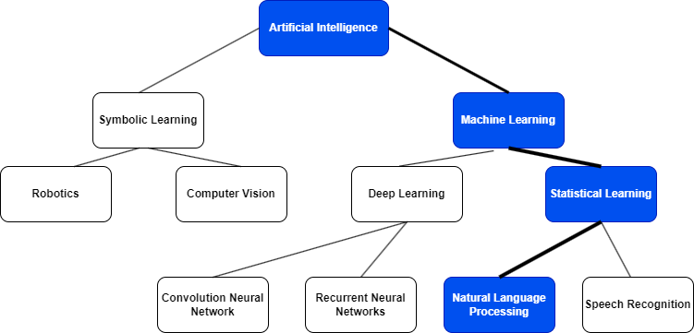
Concept Tree

Slide 5
Literature
Sl.No | Author | Strategies | Advantages | Disadvantages
1. | A. Zubiaga | Analyzing the behavior of users sharing the rumor, identifying suspicious patterns like unusually high activity or shared characteristics among rumor spreaders, temporal dynamics, and user engagement analysis | The paper identifies open research questions and highlights opportunities for further exploration in new areas like visual analysis and leveraging external knowledge sources | Limited Scope of Rumors
2. | E. Wahyu Pamungkas | Analyze the structure of the conversation thread surrounding the rumor, including the position of the tweet in the thread and its connections to other tweets | Analyzing the conversation structure provides valuable context for interpreting the user's intent and stance. | Data Dependency: The model's performance relies heavily on the quality and size of the annotated data used

Slide 6
Literature
Sl.No | Author | Strategies | Advantages | Disadvantages
3. | E. Kochkina, M. Liakata, | A multi-task learning approach for rumor verification, where multiple related tasks are trained simultaneously in a single model | It requires training only one model instead of multiple, reducing training time | Multi-task learning models can be more complex and challenging to train compared to single-task models.
4. | Z. Wang Y. Guo, | Proposes a novel approach for detecting rumor events based on sentiment analysis and temporal dynamics | Utilizing a CNN leverages the strengths of deep learning for feature extraction and pattern recognition | Training and deploying CNN models can be computationally expensive, requiring significant resources

Slide 7
Problem Statement
In today's fast-moving world of Twitter, quickly identifying and checking rumors is crucial because they can have significant effects. Current methods are somewhat effective but are not fast enough and don't fully grasp the subtleties of language needed for this job. The BERT model, known for its advanced language processing skills, could be a good solution, but it's not yet fine-tuned for the brief and specific style of Twitter, causing problems with speed and flexibility. This project aims to adapt BERT to work better with Twitter, making it quicker and more effective at spotting rumors. This improvement aims to stop the spread of false information and make the information on social media more trustworthy.

Slide 8
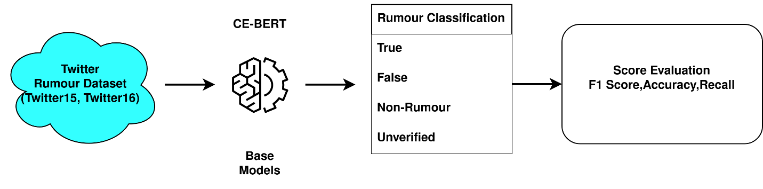
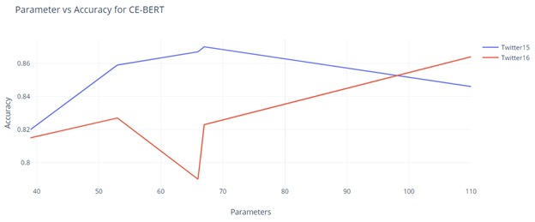
Problem Illustration
Model | Parameters | Accuracy
CE-BERT | 53M | 0.867
ALBERTA* | 66M | 0.89
DistilBERT* | 66M | 0.88

Slide 9
Proposed Method
Step 1:Installing Python libraries.
Step 2:Datasets Installation.
Step 3:Implementing ALBERT and DistilBERT.
Step 4:Model Training and Optimization.
Step 5:Performance Evaluation.
Step 6:Comparative Analysis.
Step 7:Results and Conclusion.

Slide 10
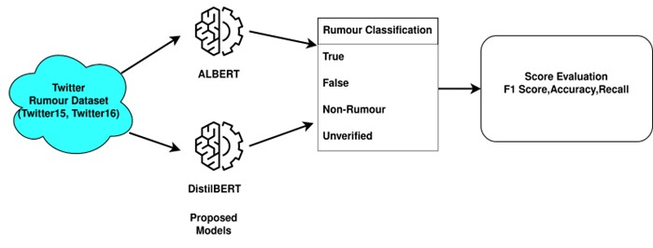
Proposed Method Illustration

Slide 11
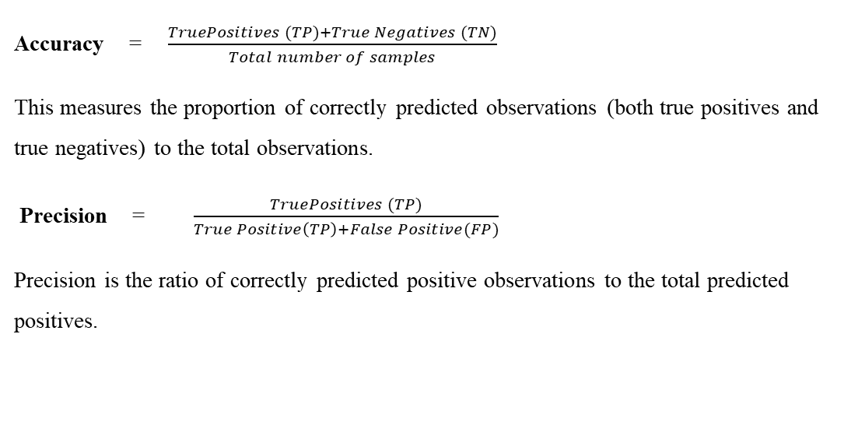
Parameter
Accuracy = $\frac{TruePositives (TP)+True Negatives (TN)​}{Total number of samples}$
This measures the proportion of correctly predicted observations (both true positives and true negatives) to the total observations.
Precision = $\frac{TruePositives (TP)​}{True Positive\left(TP\right)+False Positive(FP)}$
Precision is the ratio of correctly predicted positive observations to the total predicted positives.

Slide 12
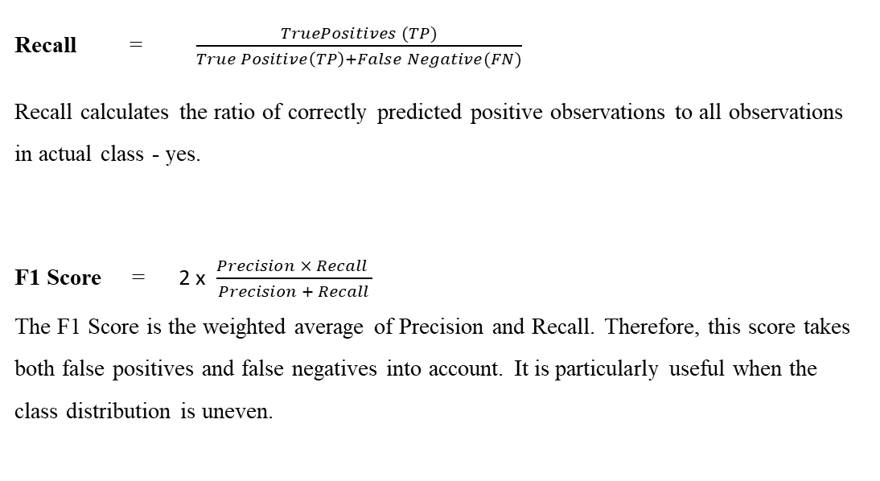
Parameter
Recall = $\frac{TruePositives (TP)​}{True Positive\left(TP\right)+False Negative(FN)}$
Recall calculates the ratio of correctly predicted positive observations to all observations in actual class - yes.
F1 Score = 2 x $\frac{Precision × Recall ​}{Precision + Recall}$ The F1 Score is the weighted average of Precision and Recall. Therefore, this score takes both false positives and false negatives into account. It is particularly useful when the class distribution is uneven.

Slide 13
Experiment Environment
The environment used is Google Colab, Google Drive, Hugging Face and Streamlit
The packages used in our Python code are:
NumPy: To work with arrays or matrices.
Transformers: This package from Hugging Face offers thousands of pre-trained models.
Shutil, os: This package provides a range of functions to interact with the file system.
Pandas: Used for loading and preprocessing the dataset, including reading CSV files.
Datasets: Part of the Hugging Face's ecosystem, this package is designed for loading, transforming, and managing large-scale datasets in a streamlined manner.
Torch: Used for applications such as computer vision and natural language processing.
Sklearn.metrics: This module provides a set of simple and efficient tools for data mining and data analysis.

Slide 14
References
[1] J. Devlin, M.-W. Chang, K. Lee, and K. Toutanova, ‘‘BERT: Pre-training of deep bidirectional transformers for language understanding,’’ 2018, arXiv:1810.04805..
[2] A. Zubiaga, M. Liakata, R. Procter, K. Bontcheva, and P. Tolmie, ‘‘Towards detecting rumours in social media,’’ 2015, arXiv:1504.04712.
[3] A. Bondielli and F. Marcelloni, ‘‘A survey on fake news and rumour detection techniques,’’ Inf. Sci., vol. 497, pp. 38–55, Sep. 2019..
[4] Y. Wang, S. Qian, J. Hu, Q. Fang, and C. Xu, ‘‘Fake news detection via knowledge-driven multimodal graph convolutional networks,’’ in Proc. Int. Conf. Multimedia Retr., Jun. 2020, pp. 540–547.
[5] ] Z. Wu, D. Pi, J. Chen, M. Xie, and J. Cao, ‘‘Rumor detection based on propagation graph neural network with attention mechanism,’’ Exp. Syst. Appl., vol. 158, Nov. 2020, Art. no. 113595.

Slide 15
Thank you

